Slide 1
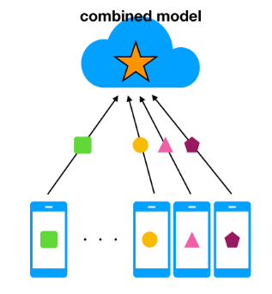

Bounty based federated learning
of Neural Networks
Prashanth Thipparthi

Slide 2
Problem Statement
Federated Learning is a distributed machine learning approach which enables model training on a large corpus of decentralised data
How can we reward the device which contributes more to the learning process of the model ?
This project aims to reward the device which contributes more data towards the learning of the central model using the hyperledger fabric.

Slide 3
Related Work
“Federated learning: Strategies for improving communication efficiency”[1]: Federated learning was initially proposed in this paper. The paper proposes to mitigate the issue of ownership and privacy of proprietary machine learning data.where an owner sends the training model to users who train on their local data and send back only the updated weights of the model. By doing this, a user never unveils his data to the owner, and keeps ownership of his data. A secondary result of this type of training is that users with sensitive data such as health care data are more likely to partake in the training, meaning the owner also receives more data to use for training.

Slide 4
Related Work (cont)
On-device federated learning via blockchain and its latency analysis[4]: Blockchained FL (BlockFL) architecture proposed in this citation has the blockchain network which enables exchanging devices’ local model updates while verifying and providing their corresponding rewards. BlockFL overcomes the single point of failure problem and extends the range of its federation to untrustworthy devices in a public network. It has a validation process of the local training results.
The payment to devices is left to the miner to pay ”out-of-pocket”, which is not a scalable solution.

Slide 5
Related Work (cont)
Deepchain: Auditable and privacy-preserving deep learning with blockchain-based incentive[5] : This paper presents a distributed, secure, and fair deep learning framework named DeepChain to solve these problems. DeepChain provides a value-driven incentive mechanism based on blockchain to force the participants to behave correctly.
The blockwise-BA consensus protocol proposed relies on cryptographically selecting a worker to create a block which is validated by a committee; this method relies on choosing an honest committee, and for the random algorithm to be negligibly close to perfectly random, both issues which may not be true in practice.

Slide 6
Related Work (cont)
Trustless machine learning contracts;evaluating and exchanging machine learning models on the ethereum blockchain[6]: This paper proposed an Ethereum blockchain implementation of machine learning to reward users for producing trained models for organizers. Given an organizer’s published dataset and evaluation function, users compete to produce the first or the best training model that maximizes this evaluation function.
One large problem that arises with this system is that all model evaluations are done on the blockchain which yields large gas costs; many users must each pay gas for their models to be evaluated, however only one or two users are paid out.

Slide 7
Related Work (cont)
Record and Reward Federated Learning Contributions with Blockchain[3]: This project burrows some of the implementation ideas and concepts from this research paper.

Slide 8
Preliminary Ideas (Design, Implementation)
Implementation can be divided into two parts
Federated Learning
Hyperledger fabric

Slide 9
Preliminary Ideas (Design, Implementation) Cont
Federated Learning:Working on Simulation of 1 parameter server and 2 devices.
Data Set: Fashion-MNIST: a Novel Image Dataset for Benchmarking Machine Learning Algorithms(https://arxiv.org/abs/1708.07747)
Installation dependencies:
Python 3
TensorFlow - Federated
Hyperledger fabric: Going through tutorials on hyperledger fabric and trying to create the blockchain network for the same.

Slide 10
Preliminary Ideas (Design, Implementation) Cont
All the devices, D will be sending the following parameters to the parameter server.
TxID - Unique identifier of the transaction
ai - Address of device Di
H(δi) - SHA256 Hash of binary representation of training model weight updates
ni - The data cost – number of data points used to calculate the model update
vi - The current version k of Tk
v, r, s - Signature of hash of the transaction
Parameter server aggregates all the updates from the devices and places them in the queue, in order to send them to the hyperledger fabric.

Slide 11
Preliminary Ideas (Design, Implementation) Cont
Smart Contracts:
UploadGradient(): Parameter server will be sending TransactionID, address of device(ai), Hash of training model weight updates, the data cost(ni), Signature of hash of the transaction to the hyperledger.
After verification of the address of device, signature of hash of the transaction and other parameters hyperledger will create a block and calls the payment() smart contract.
Payment(): Once a transaction from device Di ∈ D is validated, this Smart Contract is triggered to send payment proportional to the data cost ni to address ai.

Slide 12
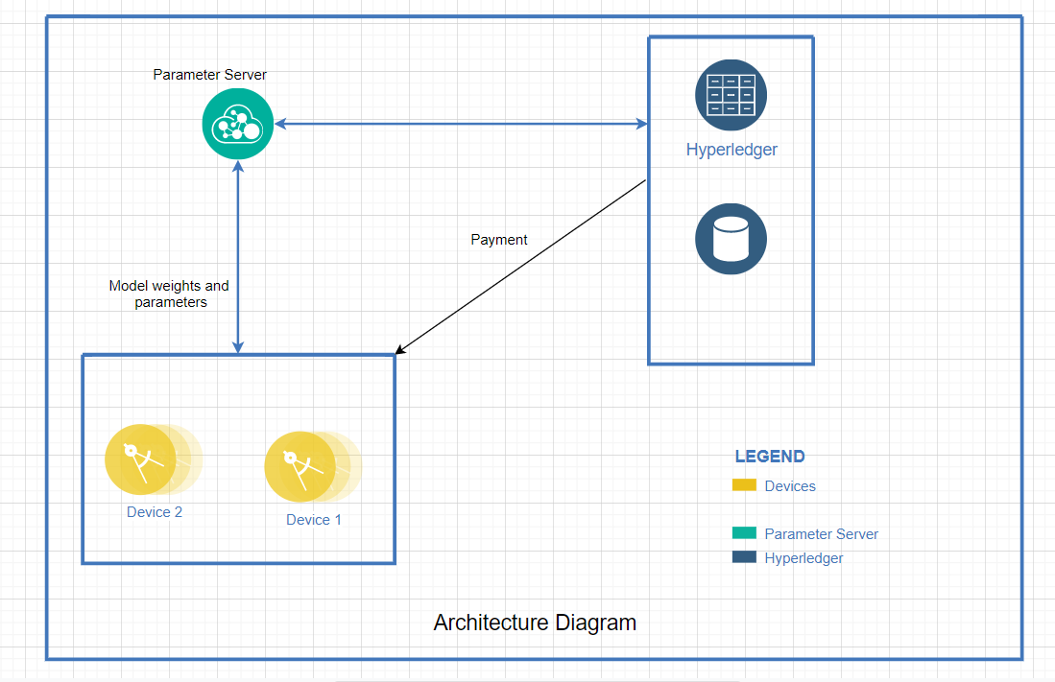
Architecture Diagram

Slide 13
So what ?
The above application can be hosted as a cloud service where multiple applications can use the service.

Slide 14
References
[1] J. Koneny, H. B. McMahan, F. X. Yu, P. Richtrik, A. T. Suresh, and D. Bacon.“Federated learning: Strategies for improving communication efficiency”, arXiv preprint arXiv:1610.05492, 2016.
[2] B. McMahan and D. Ramage, “Federated Learning: Collaborative machine learning without centralized training data”, Google Research Blog, 2017.
[3] I. Martinez, S. Francis and A. S. Hafid, "Record and Reward Federated Learning Contributions with Blockchain," 2019 International Conference on Cyber-Enabled Distributed Computing and Knowledge Discovery (CyberC), Guilin, China, 2019, pp. 50-57.
[4] H. Kim, J. Park, M. Bennis, and S.-L. Kim. “On-device federated learning via blockchain and its latency analysis”, arXiv preprint arXiv:1808.03949, 2018.
[5] J. Weng, J. Weng, J. Zhang, M. Li, Y. Zhang, and W. Luo, “Deepchain: Auditable and privacy-preserving deep learning with blockchain-based incentive”, Cryptology ePrint Archive, Report 2018/679, 2018

